Slide 1
Make Your Power System
More Secure,
More Reliable

Slide 2
BM3000 Battery Monitoring System
Keep an eye on your batteries

Slide 3
Over 13+ Years Experiences in design
and manufacture battery monitoring system

Slide 4
Lithium BMS
HOME
Product
News
Application
Support
About Us
Contact
VRLA BMS
Lithium BMS
Nicad BMS
Relat Clouds
Relat Software
Industry News
Company News
Exhibition
Data Center
Power Plant
Telecom
Rail Transport
Technical
Service
Download
Company Profile
Milestone
Award & Certificate
联系我们 Contact
英文地址Address: Suite A602, Huachuangda Center, Xinhua No.1 Rd, Bao'an District, Shenzhen
联系电话Phone: +86 18680390897
邮箱： chelsea@relatele.com
公司社交媒体平台
领英链接：https://www.linkedin.com/company/relat-technology
脸书链接：https://www.facebook.com/Relat-BMS-108874270625494/
阿里巴巴链接：https://relat.en.alibaba.com/

Slide 5
愿景：让电池更安全
使命：为所有客户提供最优质的蓄电池监控产品和服务
价值观：诚信、价值、积极
经营理念：质量第一，顾客满意，创造品牌，持续改进
VISION: Bring secure to batteries and overall power system
MISSION: Dedicated to providing innovative battery monitoring devices and exceptional service with unparalleled execution for all of our customer.
VALUES: Integrity,Values,Energetic
Business Philosophy:
Quality Comes First, Customer Satisfaction,Brand Building,Keep Improving

Slide 6
We are a leading product manufacturer and solution provider in the field of battery monitoring, determinded to bring the secure to the batteries. Our R&D team was founded by a team of engineer with 20 years experiences in electronic engineering in 2015. The development and manufacture of battery monitoring system are combined with cut-edge EDA design technology, robust reliability design technology, white box testing technology. In August 2008, Shenzhen Relat Electronic Technology Co., Ltd. was founded. We research,development and manufacture of battery monitoring system for various sector like data center, telecom base station, power plant, rapid transit railway, semiconductor,medicine, bank, securities,insurance and etc. We dedicate to providing innovative battery monitoring devices and exceptional service with unparalleled execution for all of our customer. We are steadily creating a long-term future plan and are progressing towards the goal of building a world-class brand with all of our global partners and distributors, which will allow us to go forward into the next decade and beyond.
About Us- Company Profile

Slide 7
About Us- Milestone
2008年公司成立 2008年第一代电池监控系统研发完成并实现商用
Relat was founded in 2008 and lauched the 1st Generation Battery Monitoring System.
2009年中标华能集团发电厂电池监控项目，取得电力行业批量应用
We awarded of tender of Huaneng Group, and promteded it in the whole Utility Industry.
2011年独家中标招商银行总行及全国分行的蓄电池监控系统集采项目
We awarded of tender of battery monitoring system of China Merchants Bank with all branches in China.
2012年推出第三代单体式电池监控系统。国内最早，已成为现在主流产品
We launched the 3rd Generation modular level battery monitoring system which is the earliest supplier in China.
2015年与母公司一起在新三板成功上市;2015年成为建行武汉灾备中心6万节电池监控项目第二供应商；中标中国证券期货南方信息数据中心1.2万节电池监控项目。
We listed on New Three Board with Parent Company. CCB Wuhan Disaster Backup and Recovery Center, one of Asia's largest financial data center, appointed Relat as the second supplier of battery monitoring system for 60,000 nos of batteries.We awarded of tendof battery monitoring system of China Southern Information Technology Center for Securities and Futures Industry (SSCC) for 12,000 nos of batteries in 2015.
2016年再次中标续签招商银行总行框架采购项目
2016年中标数据中心知名企业世纪互联IDC电池监控项目并入围供应商短名单。
We awarded the tender of 21Vianet of battery monitoring system and in the short list of their supplier of battery monitoring system in 2016. 21Vianet is the leading service provider of data center in China.
2017年成为工商银行总行指定的电池监控品牌供应商. We awarded of the Major Brand Suppliers of ICBC Bank
2018年公司成立10周年;中标中国电信京东云数据中心 ；再次中标招商银行总行及全国分行的蓄电池监控系统集采项目.
The 10th Anniversary of Relat, We awarded of Tender of China Telecom of JD Cloud Centers in 2018
2019年瑞雷特云平台-瑞联智云上线 . We Launched Relat Smart Clouds in 2019
2020年中标半导体项目：国家存储器基地工程（一期）二阶段工程项目第四次中标招商银行总行及全国分行的蓄电池监控系统集采项目
We awarded battery monitoring system project of National Storage Project in Semicounductors industry. The 4th time awarder of tender of battery monitoring system of China Merchants Bank with all branches in China.

Slide 8
About Us, Relat is a leading product manufacturer and solution provider in the field of battery monitoring, determinded to bring the secure to the batteries.
Milestones, Relat was founded in 2008 which is the earliest battery montioring supplier in China.
Download Center, Relat dedicate to providing innovative battery monitoring devices and exceptional service with unparalleled execution for all of our customer.

Slide 9
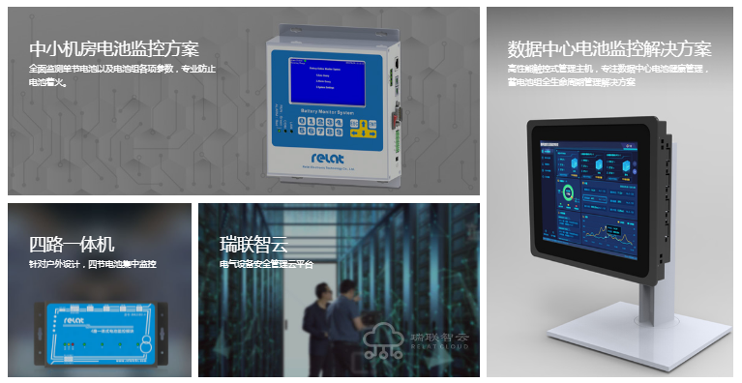
Mini Data Center Battery Monitoring System Solution
- Modular level Monitoring
- Remote Monitoring for all batteries
- Export Charge & Discharg Reprot
Data Center Battery Monitoring System Solution
-10 inch LCD Full HD Touch Screen bring you perfect visual experience.
-Use huge data analysistechnologies, collecting all battery data in second level
4 IN ONE Controller
- 48VDC systems using (4) 12V batteries.
Relat Smart Clouds
-Monitoring all electrical equipments

Slide 10
技术研发
从概念设计、产品设计、应用集成到生产验证，已经具备全球领先的正向研发能力和完善的产品开发流程
Our R&D Enginnering
We are capable of world-class research & development ability on the process of Concept, Product Desgin, Integration and Validation.
ENGINEERING CAPABILITY
研发能力
研发核心团队由行业经验十二年以上的资深软硬件工程师组成，是国内最早专注蓄电池监测产品的研发团队之一，在蓄电池特性研究，数据智能软件算法等领域积累了丰富的经验，致力于蓄电池监测管理系统相关产品的技术创新及改进。
ENGINEERING CAPABILITY
Over 13+ years developments, our engineers have gain wide industrial experiences of VRLA batteries and the cut edge techlogy for data stack and storage.We dedicate to providing innovative technology for all related battery monitoring solution.

Slide 11
INTELLIGENT MANUFACTURING
精益制造
公司通过了国际ISO9000的质量管理体系认证，从调研、设计、评审、测试、采购、制造、销售等多个环节进行严格管控，保证工作效率，实现安全、高质量、高效的生产
INTELLIGENT MANUFACTURING
We are an ISO9001 certificated company. We have robust, clearly defined procedures in place in all our business areas such as R&D, production, supply chain management, risk management, handling of documents and data and strong business continuity processes.We are providing a high-quality and consistent products and services to our clients and our ongoing investment in technology and development.
TESTING & VERIFICATION
试验验证
公司成立了专业的研发实验中心，包含产品测试实验室、EMC实验室、高低环境测试实验室，来料检测实验室等多个实验室。在产品研发过程中从物料环节到整机功能测试实现一套完整精细的实验验证，保证所有产品的可靠性、安全性及稳
TESTING & VERIFICATION
Our parent company established laboratory with sophisticated test equipment including Material Analysis Lab, EMC Lab,High Low Temperature Test Lab, Product Test Lab and etc. On the process from the raw material to the funitional verifcation and test, we formulate a complete experimental verification to guarantee the robust, relaibility and stability for all the product

Slide 12
技术支持，
Leading Technical Support
We back our battery monitoring system with industry-leading technical support which includes:​ ►Providing battery monitoring system connection diagram ►Providing installation recommendations and techinical information ►Providing technical webinar training ►Remote Assistance for troubleshooting during installation ►Remote Assistance for configuration battery monitoring software ►Technical Consulting and Post-sale Service
Technical Engineer, Engineer Chu, email: cdw@relatele.com Engineer Gao, email: gzq@relatele.com

Slide 13
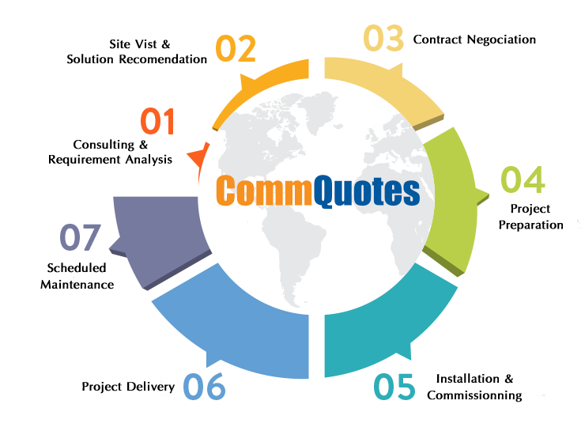
服务支持
Leading Customer Service

